Slide 1
Characterizing the Neutron Energy Distribution of the AFIT Building 470 Graphite Pile
NENG 725
30 May 2018
2d Lt Will Johnston
AFIT/ENP

Slide 2
Overview
Motivation
Schematics of the Graphite Pile
Assumptions
Source Output Energy Distribution
Composition of the MCNP Codes
Results
Questions

Slide 3
Motivation
Notes:
There is a possibility of being able to approximate yields of nuclear detonations on an urban environment
First we need to characterize the image degradation of a camera due to neutron displacement of pixels and crystals in a silicon op amp
In prep for an experiment next quarter I am running a simulation to determine the neutron energy distribution at various points in the pile where a camera could be placed

Slide 4
Schematics of the Graphite Pile
Notes:
Five materials
50”x50”x72” graphite pile
1/32” cadmium shield surrounded by aluminum shield
Rests on an 1/2” aluminum slab above aluminum ”I” beams
wooden supports
18 crossed layers of 12 – 4”x4”x50” stringers allowing for a one inch overlap
15 removable stringers
Single stringers
Double stringers
Source stringer

Slide 5
Assumptions
Ignore:
Wooden supports
Pl in source
Aluminum I-beams
Graphite: solid block
Al enclosing: 1/32” thick
Source: 3” x 1” radius
Source strength: 1.006 x 10⁷ neutrons per second
Outside of pile: void

Slide 6
Source Output Energy Distribution
Plot Digitizer

Slide 7
Composition of MCNP Codes
Point Detectors (F5 Tally): ~ 4.5 x 10⁶ neutrons
one 3” from each side, one in the middle
Volume Tallies (F4 Tally): 10⁷ neutrons
Volume 1
Stringer 5 fully removed and filled with air
4” x 4” x 8” volume centered
Volume 2
Stringer 5 partially removed and filled with air
4” x 4” x 8” volume at the far left side
46 Energy Bins
Max: 1.964 MeV
Cutoff: 0.025 eV (thermal)

Slide 8
Results
Things to notice when viewing plots:
Individual Stringers’ Energy Distributions
Behaves as you may imagine as a whole
Side points of stringers perpendicular to source stringer are similar and lower than middle point as expected
Double stringers are similar also as expected
Partial and full removal of the stringer has a negligible effect

Slide 9
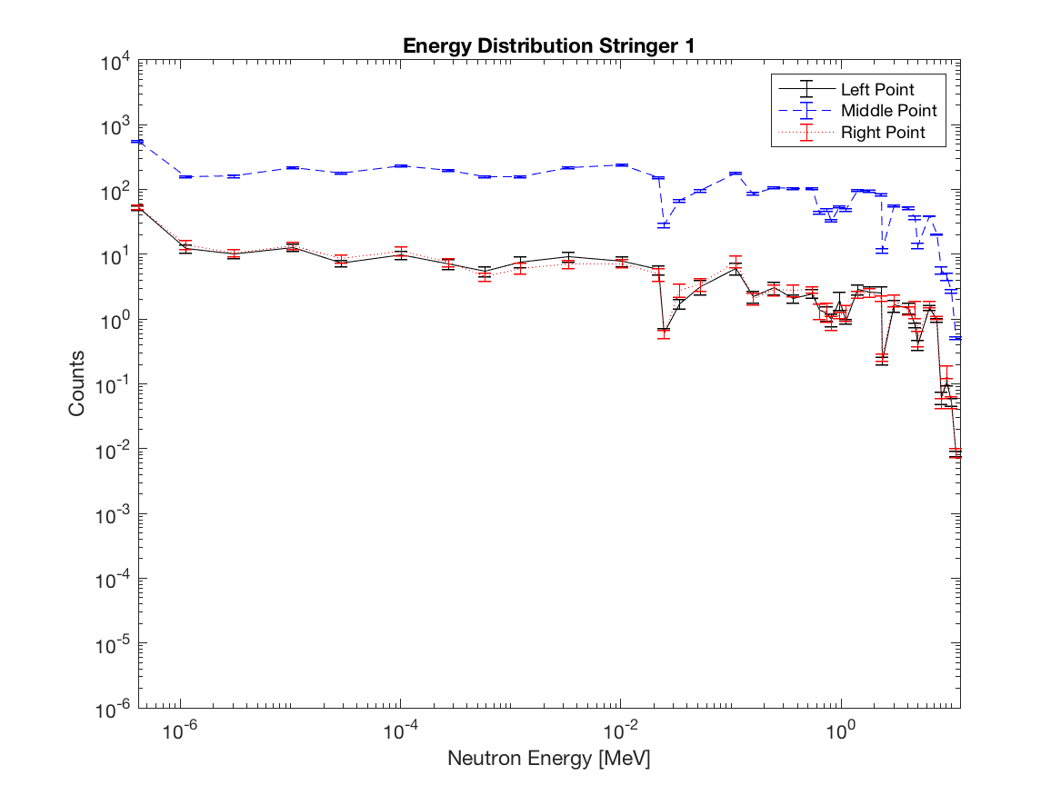
Stringer 1

Slide 10
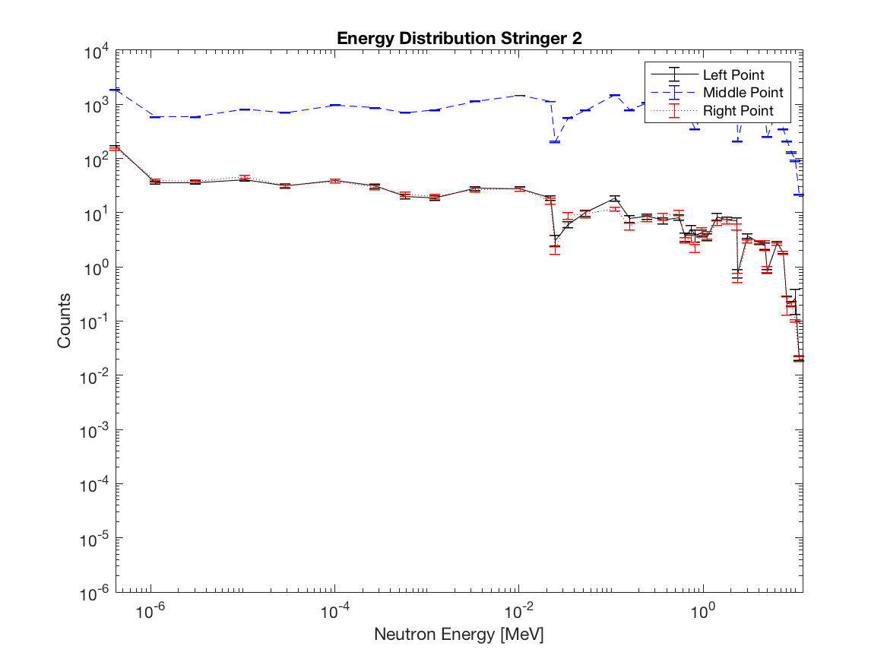
Stringer 2

Slide 11
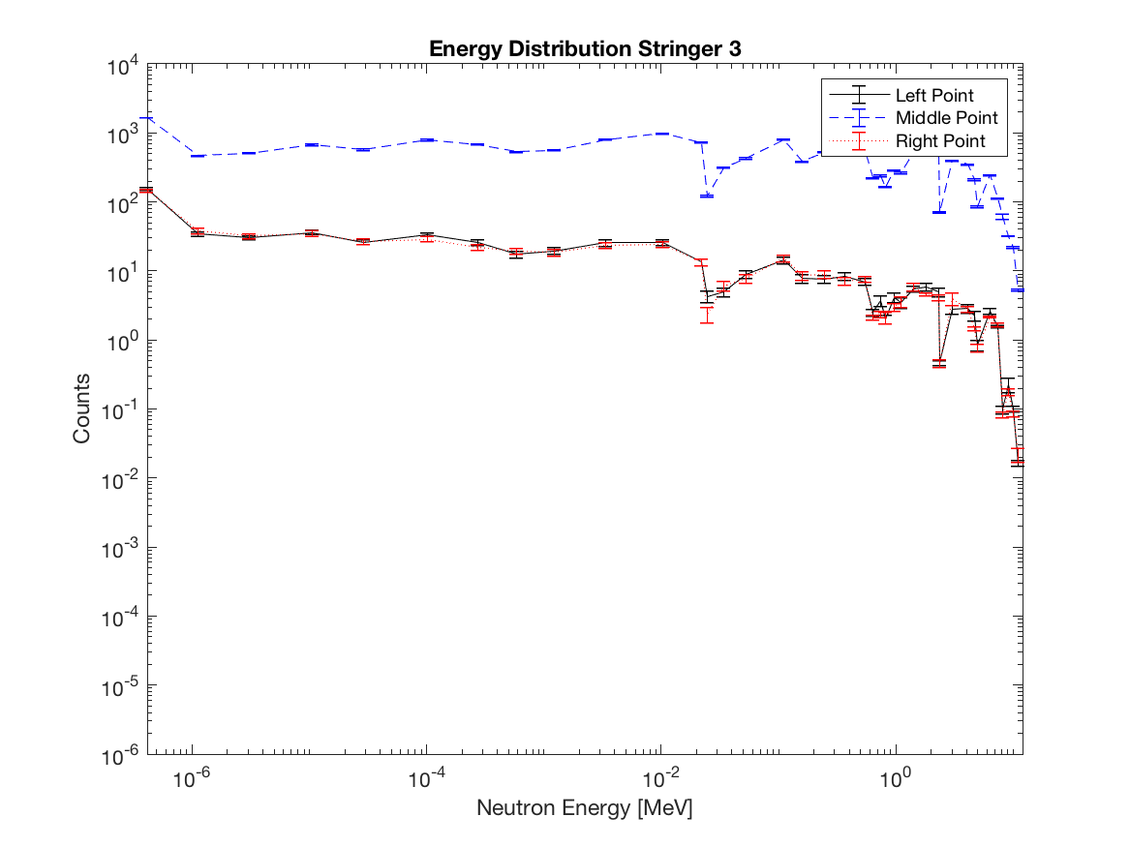
Stringer 3
Stringer 3.png

Slide 12
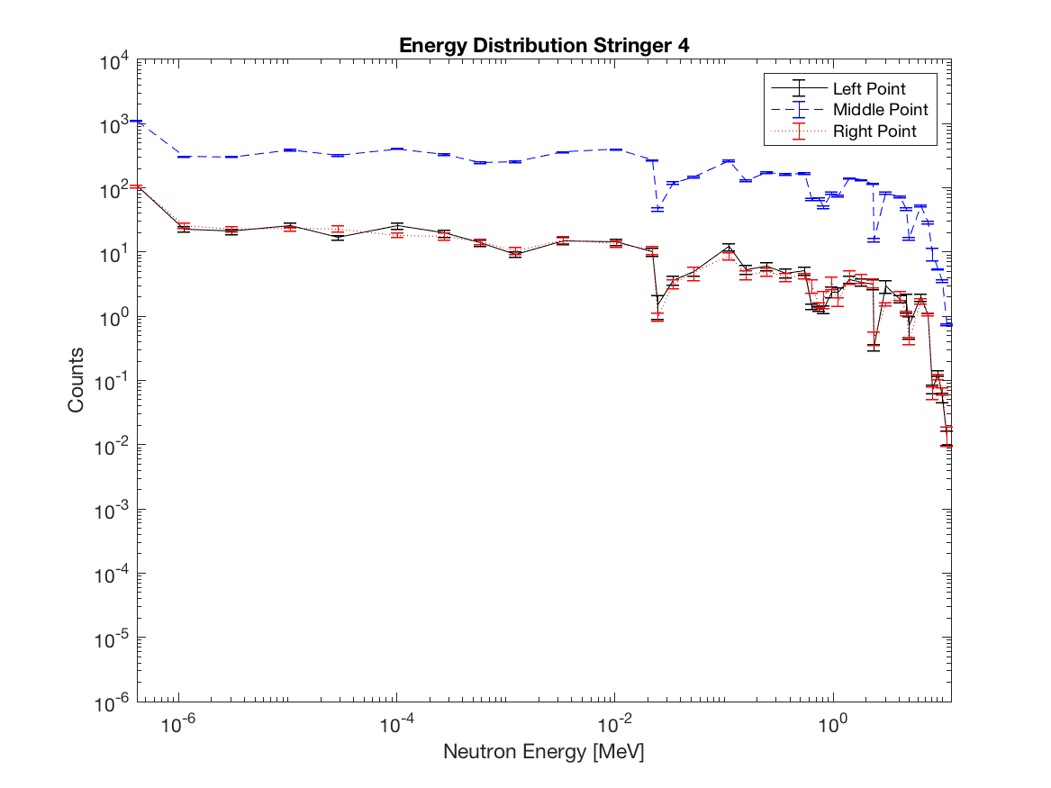
Stringer 4

Slide 13
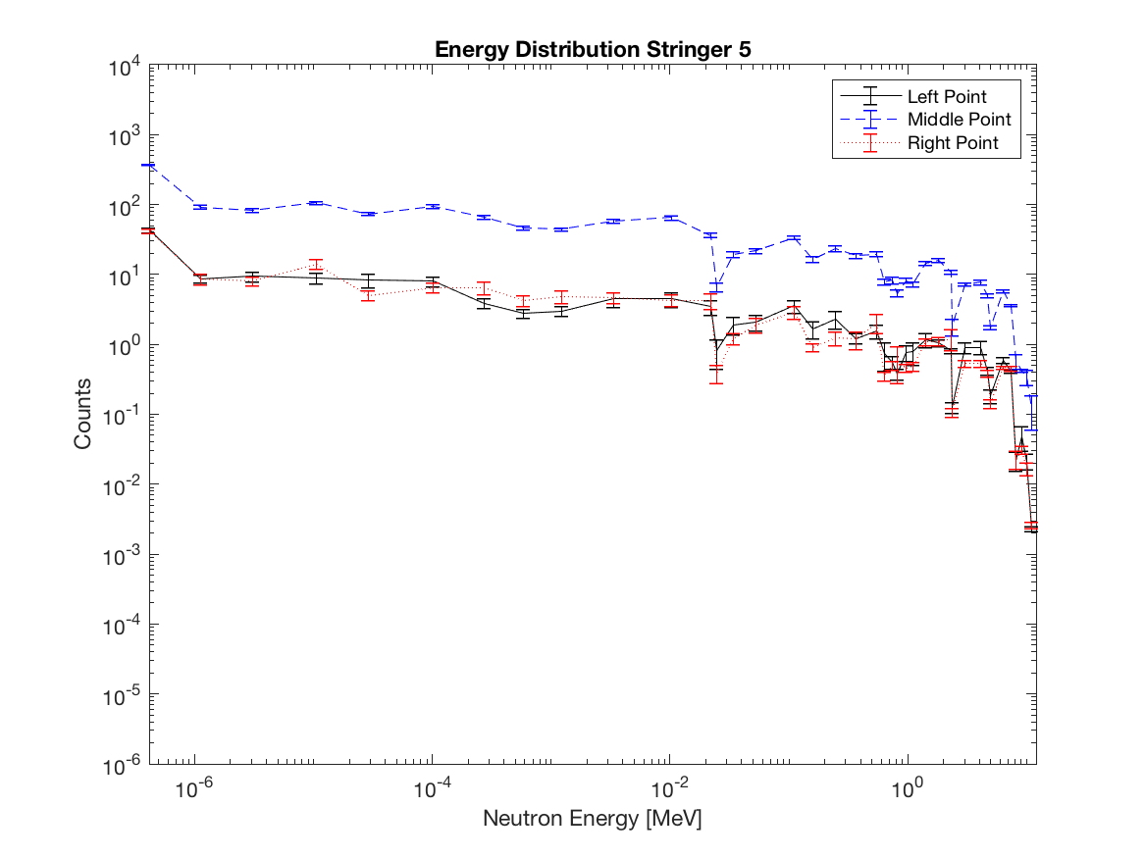
Stringer 5

Slide 14
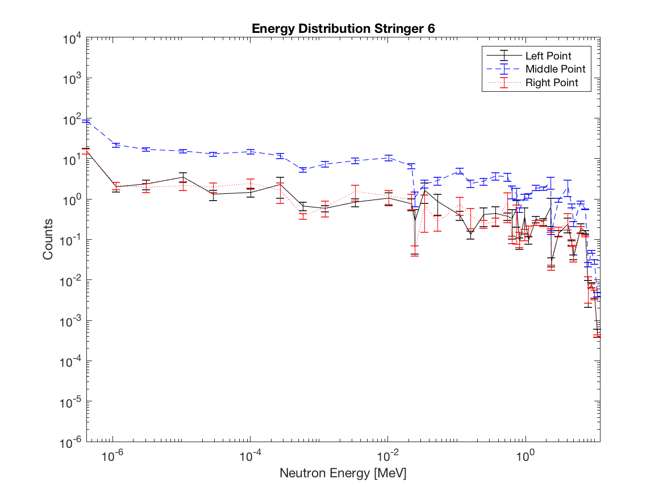
Stringer 6

Slide 15
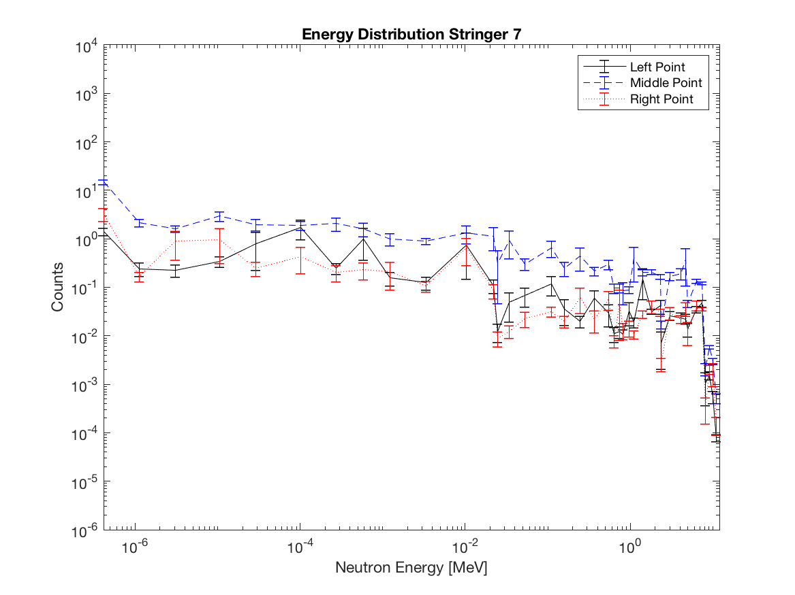
Stringer 7

Slide 16
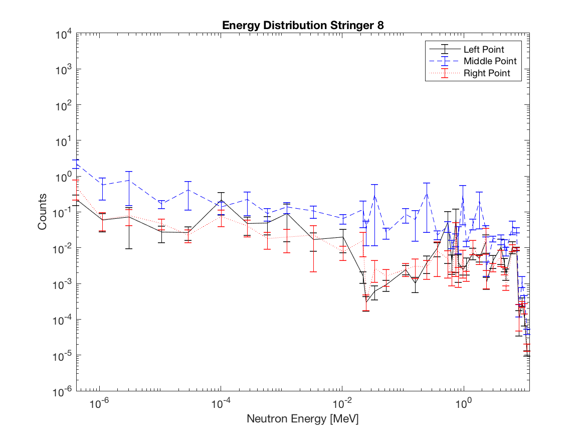
Stringer 8

Slide 17
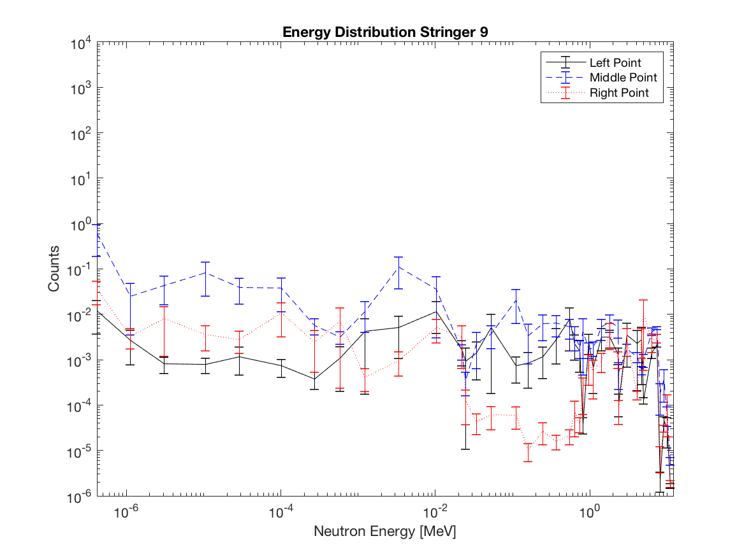
Stringer 9

Slide 18
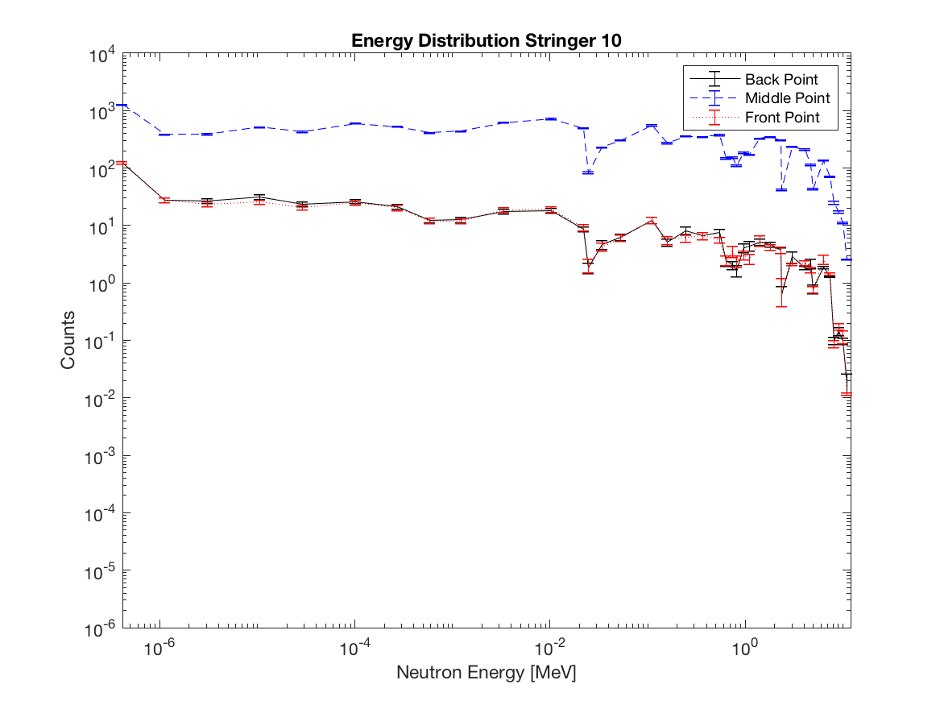
Stringer 10

Slide 19

Stringer 11 (Double)

Slide 20
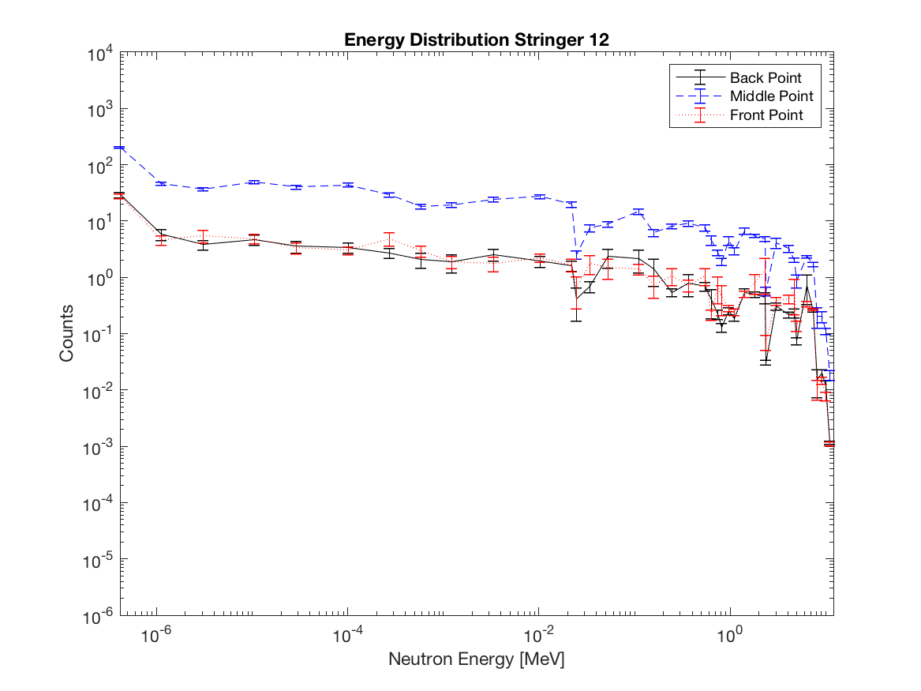
Stringer 12 (Double)

Slide 21
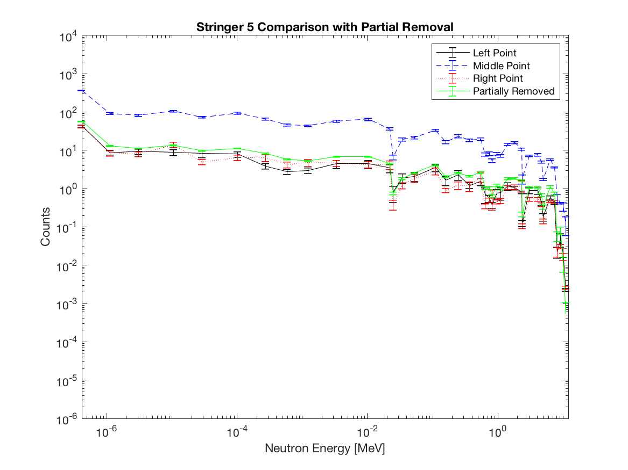
Partial Removal Comparison

Slide 22
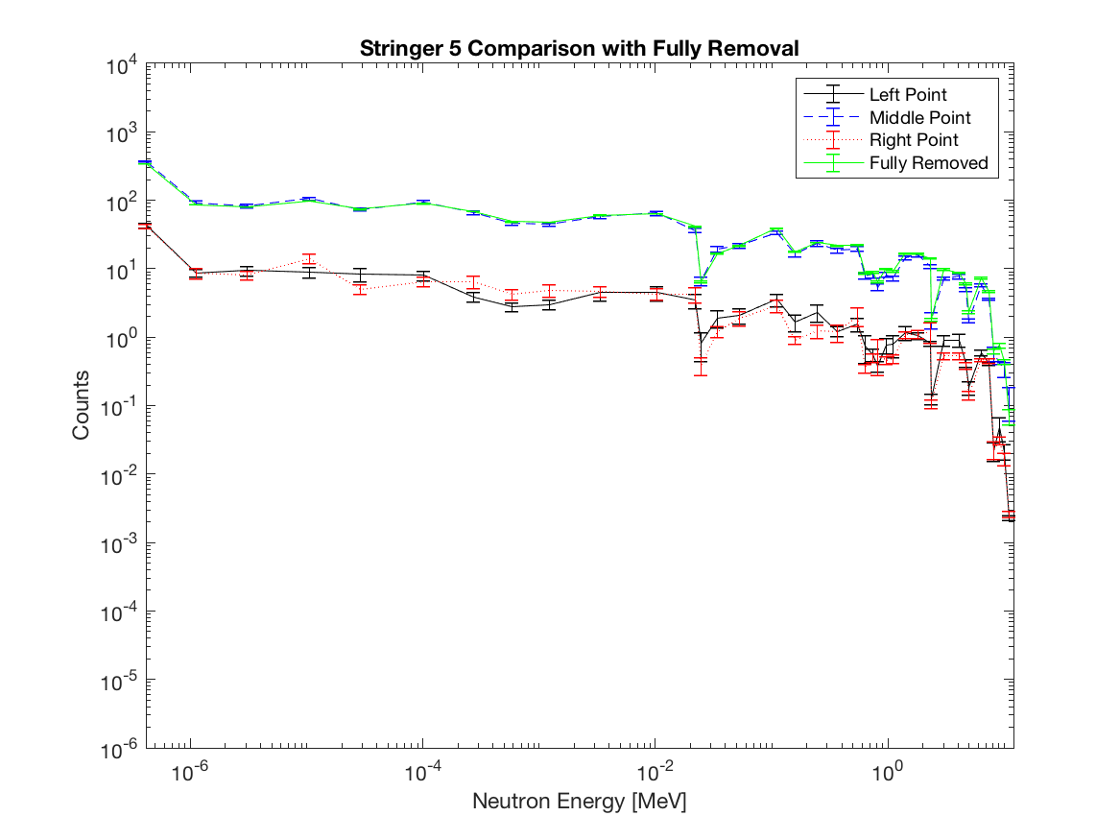
Full Removal Comparison

Slide 23
Summary
Motivation
Schematics of the Graphite Pile
Assumptions
Source Output Energy Distribution
Composition of the MCNP Codes
Results
Questions

Slide 24
Questions?
http://blog.fibertown.com/2014/02/25/the-human-factor-11-must-ask-questions-when-evaluating-data-centers/

